Slide 1
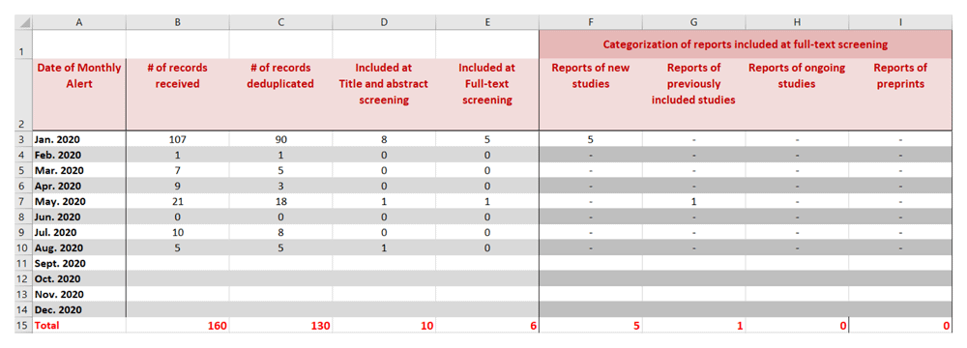

Figure 2. Snapshot of the ‘cumulative’ tab of the spreadsheet that keep track of all identified records.
Kahale LA, Elkhoury R, El Mikati I et al. Tailored PRISMA 2020 flow diagrams for living systematic reviews: a methodological survey and a proposal [version 2]. F1000Research 2021, 10:192 (doi: 10.12688/f1000research.51723.2)
Notes:
Figure 2. Snapshot of the ‘cumulative’ tab of the spreadsheet that keep track of all identified records.
Kahale LA, Elkhoury R, El Mikati I et al.. Tailored PRISMA 2020 flow diagrams for living systematic reviews: a methodological survey and a proposal [version 2]. F1000Research 2021, 10:192 (doi: 10.12688/f1000research.51723.2)

Slide 2
Identification of studies via databases and registers
Records identified from*:
Databases (n = )
Registers (n = )
Records removed before screening:
Duplicate records removed (n = )
Records marked as ineligible by automation tools (n = )
Records removed for other reasons (n = )
Identification
Records screened
(n = )
Records excluded**
(n = )
Reports sought for retrieval
(n = )
Reports not retrieved
(n = )
Screening
Reports assessed for eligibility
(n = )
Reports excluded:
Reason 1 (n = )
Reason 2 (n = )
Reason 3 (n = )
etc.
Studies included in review
(n = )
Reports of included studies
(n = )
Included

Slide 3
Identification of studies via databases and registers
Identification of studies via other methods
Records identified from:
Previous searches, until 10 Jun 20 | Last update, 31 Jan 21ª
Databases
1,007 | 4,300
Registers
0 | 0
Records removed before screening
Previous searches, until 10 Jun 20 | Last update, 31 Jan 21
Duplicates
3 | 88
Automation
0 | 0
Other
0 | 0
Records identified from:
Previous searches, until 10 Jun 20 | Last update, 31 Jan 21
Experts
4 | 0
Records sought for retrieval
Previous searches, until 10 Jun 20 | Last update, 31 Jan 21
4 | 0
Identification
Records not retrieved
Previous searches, until 10 Jun 20 | Last update, 31 Jan 21
0 | 0
Records screened
Previous searches, until 10 Jun 20 | Last update, 31 Jan 21
1,004 | 4,212
Records excluded
Previous searches, until 10 Jun 20 | Last update, 31 Jan 21
454 | 2,788
Records sought for retrieval
Previous searches, until 10 Jun 20 | Last update, 31 Jan 21
550 | 1,424
Records not retrieved
Previous searches, until 10 Jun 20 | Last update, 31 Jan 21
0 | 0
Screening
Records assessed for eligibility
Previous searches, until 10 Jun 20 | Last update, 31 Jan 21
550 | 1,424
Records excluded
Previous searches, until 10 Jun 20 | Last update, 31 Jan 21
456 | 1,342
Publication not on COVID-19 = 9 No original data = 49 Data included in other publication = 8 Insufficient extractable data = 43 Study design inappropriate = 142 No PCR/serological test = 2 Math. Model not in review scope = 130 Inadequate follow-up time = 33 Preprint of published article = 8 Other = 32 | Publication not on COVID-19 = 13 No original data = 88 Data included in other publication = 9 Insufficient extractable data = 111 Study design inappropriate = 519 No PCR/serological test = 123 Math. Model not in review scope = 213 Inadequate follow-up time = 236 Preprint of published article = 10 Other = 20
Records assessed for eligibility
Previous searches, until 10 Jun 20 | Last update, 31 Jan 21
4 | 0
Records excluded
Previous searches, until 10 Jun 20 | Last update, 31 Jan 21
4 | 0
Math. Model not in review scope = 4
New studies included in review
Previous searches, until 10 Jun 20 | Last update, 31 Jan 21
39* (prev. 94*) | 82*
Prop. of asymptomatic people = 28 (prev. 79*) Secondary attack rate = 5 (prev. 5*) Mathematical modelling study = 6 (prev. 8*) | Prop. of asymptomatic people (Q1) = 93 Secondary attack rate (Q2.1) = 5 Mathematical modelling study (Q2.2) = 8
ªWe also included published versions of pre-prints that were identified after 31 Jan 20
*Note that some studies provided information for more than one question.
*The protocol was updated after update 2 and some studies were excluded based on updated inclusion criteria. The number in parenthesis represent the total number of studies included previously. See S7 Appendix for the reasons for excluding these studies.
Included

Slide 4
Identification of studies via databases and registers
Identification of studies via other methods
Records identified from:
Previous searches, until 10 Jun 20 | Last update, 31 Jan 21ª
Databases
1,007 | 4,300
Registers
0 | 0
Records removed before screening
Previous searches, until 10 Jun 20 | Last update, 31 Jan 21
Duplicates
3 | 88
Automation
0 | 0
Other
0 | 0
Records identified from:
Previous searches, until 10 Jun 20 | Last update, 31 Jan 21
Experts
4 | 0
Identification
Records screened
Previous searches, until 10 Jun 20 | Last update, 31 Jan 21
1,004 | 4,212
Records excluded
Previous searches, until 10 Jun 20 | Last update, 31 Jan 21
454 | 2,788
Records sought for retrieval
Previous searches, until 10 Jun 20 | Last update, 31 Jan 21
550 | 1,424
Records not retrieved
Previous searches, until 10 Jun 20 | Last update, 31 Jan 21
0 | 0
Records sought for retrieval
Previous searches, until 10 Jun 20 | Last update, 31 Jan 21
4 | 0
Records not retrieved
Previous searches, until 10 Jun 20 | Last update, 31 Jan 21
0 | 0
Screening
Records assessed for eligibility
Previous searches, until 10 Jun 20 | Last update, 31 Jan 21
550 | 1,424
Records excluded
Previous searches, until 10 Jun 20 | Last update, 31 Jan 21
456 | 1,342
Publication not on COVID-19 = 9 No original data = 49 Data included in other publication = 8 Insufficient extractable data = 43 Study design inappropriate = 142 No PCR/serological test = 2 Math. Model not in review scope = 130 Inadequate follow-up time = 33 Preprint of published article = 8 Other = 32 | Publication not on COVID-19 = 13 No original data = 88 Data included in other publication = 9 Insufficient extractable data = 111 Study design inappropriate = 519 No PCR/serological test = 123 Math. Model not in review scope = 213 Inadequate follow-up time = 236 Preprint of published article = 10 Other = 20
Records assessed for eligibility
Previous searches, until 10 Jun 20 | Last update, 31 Jan 21
4 | 0
Records excluded
Previous searches, until 10 Jun 20 | Last update, 31 Jan 21
4 | 0
Math. Model not in review scope = 4
ªWe also included published versions of pre-prints that were identified after 31 Jan 20
*Note that some studies provided information for more than one question.
*The protocol was updated after update 2 and some studies were excluded based on updated inclusion criteria. The number in parenthesis represent the total number of studies included previously. See S7 Appendix for the reasons for excluding these studies.
New studies included in review
Previous searches, until 10 Jun 20 | Last update, 31 Jan 21
39* (prev. 94*) | 82*
Prop. of asymptomatic people = 28 (prev. 79*) Secondary attack rate = 5 (prev. 5*) Mathematical modelling study = 6 (prev. 8*) | Prop. of asymptomatic people (Q1) = 93 Secondary attack rate (Q2.1) = 5 Mathematical modelling study (Q2.2) = 8
Included

